Slide 1
HEART DISEASE CLASSIFICATIONS
USING MACHINE LEARNING

Slide 2

A Project Submitted in Partial Fulfillment of the Requirement for the Degree of
MASTER OF TECHNOLOGY
in
Big Data Analytics
by
Manish Kumar Singh
DS7B-2206
Under the Supervision of
Dr. Dinesh Bhati
SCHOOL OF DATA SCIENCE AND FORECASTING
DEVI AHILYA VISHWAVIDHYALYA INDORE

Slide 3


Agenda
A
Logistic Regression
Forward Propagation
K-Nearest Neighbour (KNN) Classification
Support Vector Machine (SVM) Algorithm
Naive Bayes Algorithm
Decision Tree Algorithm

Slide 4


Logistic Regression
Linear Regression Equation:
Sigmoid Function:
Apply Sigmoid function on linear regression:

Slide 5
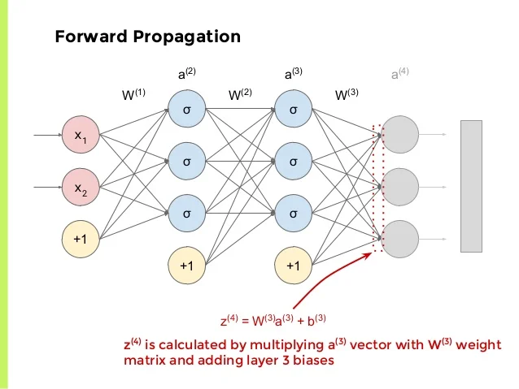
Forward Propagation

Slide 6
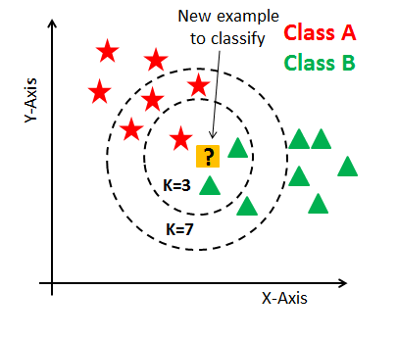
K-Nearest Neighbour (KNN) Classification

Slide 7
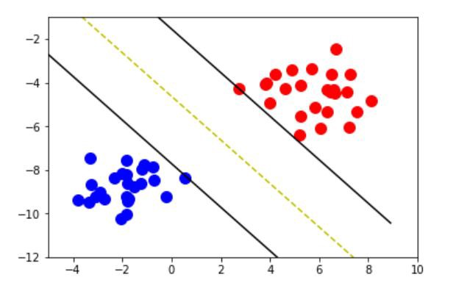
Support Vector Machine (SVM) Algorithm

Slide 8
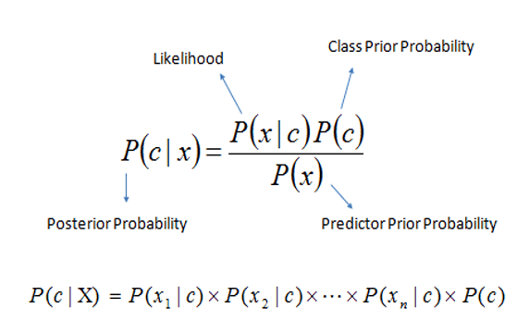
Naive Bayes Algorithm

Slide 9
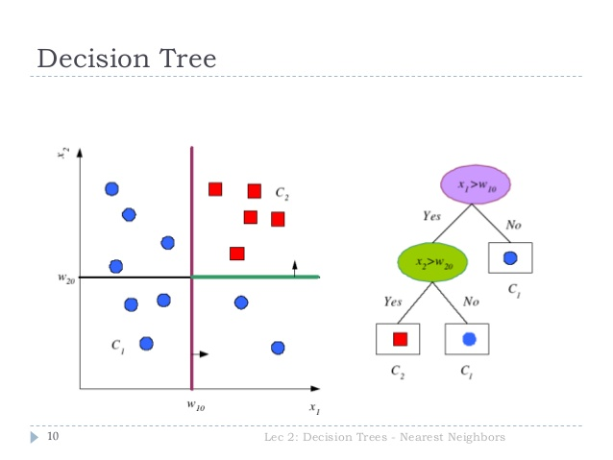
Decision Tree Algorithm

Slide 10
Thank you
Manish Kumar Singh
cs.mks@outlook.com

